Slide 1
ANALYZING AMAZON SALES DATA

Slide 2
Introduction:
Sales management is a crucial function in any business enterprise, and it has become even more important in today's competitive market. With the increasing need for improved methods of distribution to reduce costs and increase profits, sales management has become the most important function in a commercial and business enterprise. In this presentation, we will analyze the sales trend of an Amazon dataset using Extract-Transform-Load (ETL) techniques.
I

Slide 3
We will extract the sales data, transform it into a usable format, and load it into a database for analysis. We will then perform an exploratory data analysis to find key metrics and factors that influence sales. Finally, we will visualize the sales trend month-wise, year-wise, and yearly-month-wise to gain insights into the sales patterns and make data-driven decisions. Our findings will help businesses to optimize their sales strategies and improve their profitability.

Slide 4
Data Preparation
Import necessary libraries: pandas, numpy, and matplotlib.pyplot.
Load the Amazon sales data from a CSV file using the pandas library's read_csv() function.
Clean the data by removing any missing or irrelevant values. This may involve removing rows or columns with missing data, or imputing missing values using techniques such as mean or median imputation.

Slide 5
Transform the data as necessary to prepare it for analysis. This may involve aggregating data by certain dimensions (e.g., product category or time period), calculating new metrics (e.g., total sales or average price), or creating new variables (e.g., customer segments or product hierarchies).
Visualize the data using tools such as bar charts, line graphs, or scatter plots to gain insights into sales trends, customer behavior, or product performance.

Slide 6
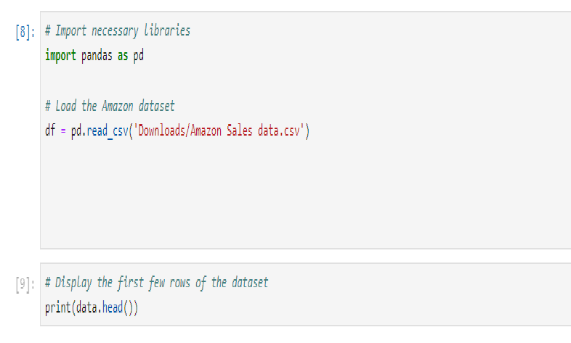
Implementation

Slide 7
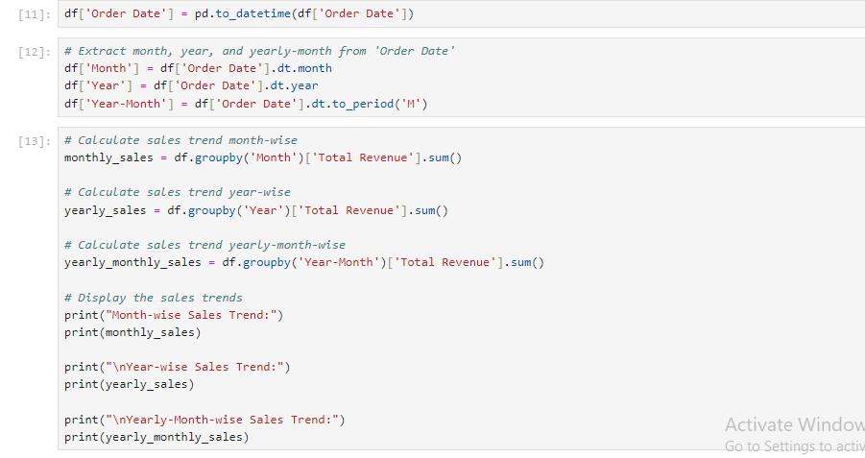

Slide 8
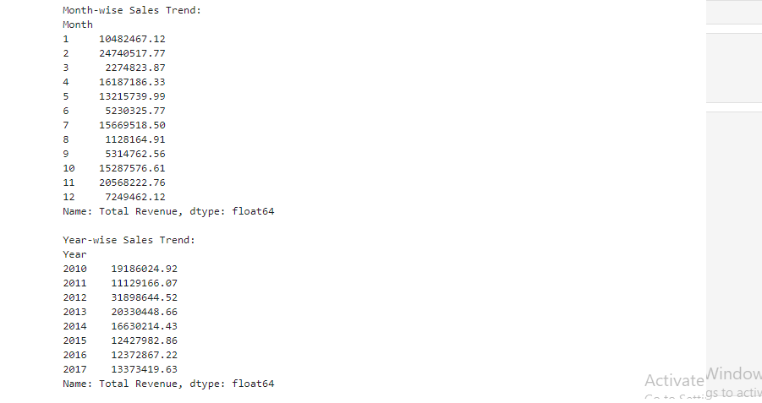
Result

Slide 9
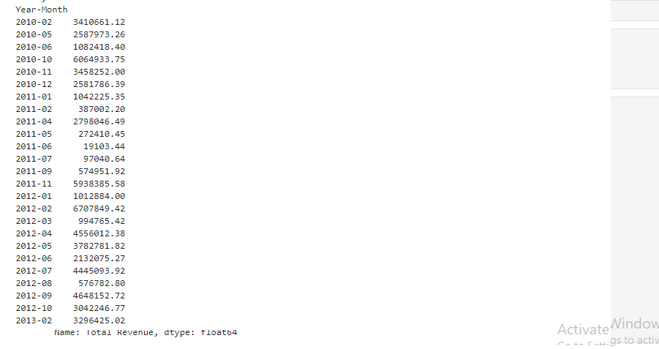

Slide 10
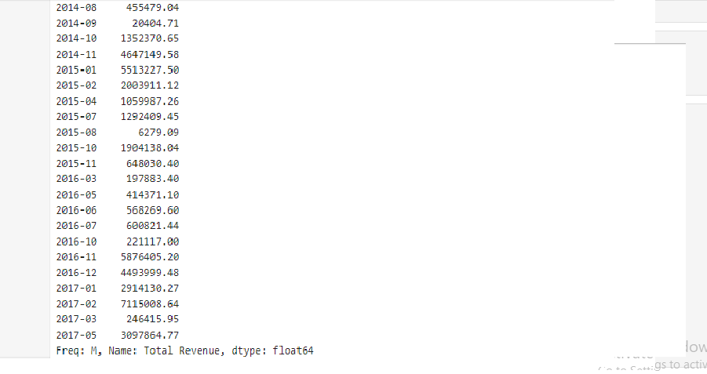

Slide 11
Conclusion
Based on the sales trend analysis, we can conclude that sales revenue is affected by seasonality, product price, and sales quantity. The sales revenue peaks in the holiday season and has been increasing over the years. To increase sales revenue, we can focus on selling more products during the holiday season and reducing product prices. Additionally, we can analyze the relationship between different factors and sales revenue to make informed decisions and improve sales management.

Slide 12
THANK YOU

